Slide 1


HTML & CSS
01
02
Introduction
03

Slide 2
Content
01
HTML Introduction
02
CSS Introduction
03
Exercises

Slide 3
01
HTML Introduction

Slide 4
What is HTML?
HTML is a markup language
HTML is the basis for creating web pages and other information that can be displayed in a web browser
Language for expressing semantic structure in textual documents

Slide 5
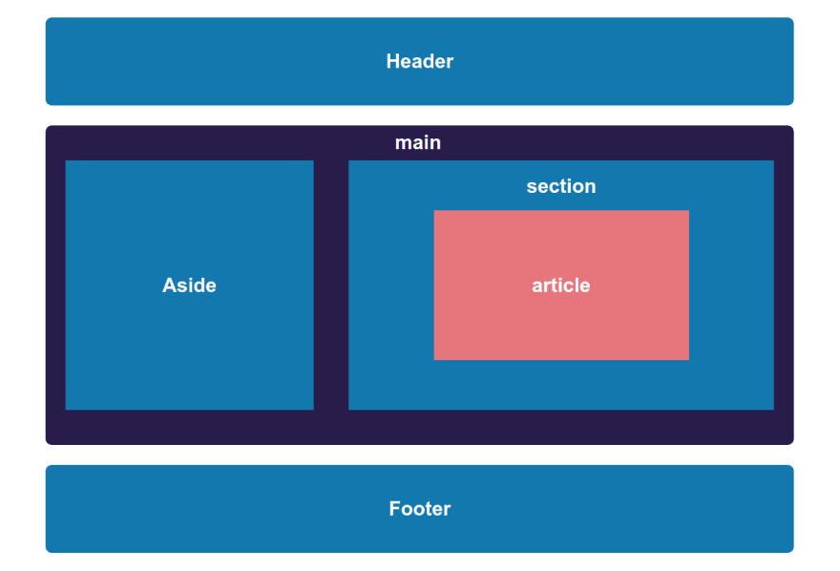
What is HTML?
Language for describing web pages
HTML documents contain HTML tags and plain text
A markup language is a set of markup tags
The tags describe document content

Slide 6
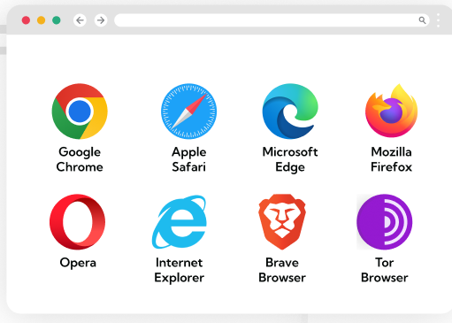
What is HTML?
HTML is consumed by web browsers
The purpose of a web browser is to read HTML documents and compose them into visible or audible web pages.
The browser does not display the HTML tags, it uses the tags to interpret the content of the page.

Slide 7
HTML Tags
Tags are keywords surrounded by angle brackets
'<' + 'html' + '>' ▸ <html> '<' + 'head' + '>' ▸ <head> '<' + 'body' + '>' ▸ <body>
'<' + 'p' + '>' ▸ <p>

Slide 8
HTML Tag Pairs
HTML tags normally come in pairs
<p> </p>
<h1> </h1>
The first tag in a pair is the start tag, the second tag is the end tag
The end tag is written like the start tag, with a forward slash before the tag name
Start and end tags are also called opening tags and closing tags

Slide 9
HTML Tag pairs
Examples
Opening Tag | Closing Tag
<html> | </html>
<head> | </head>
<body> | </body>
<p> | </p>
<title> | </title>
<h1> | </h1>

Slide 10
Main HTML Tags
Start and end of the web page/document
<html> </html>
Start and end of the metadata section of the document
<head> </head>
Start and end of the web page/document
<body> </body>
Start and end of the title section of the document
<title> </title>

Slide 11
Hello World HTML document
<html>
<head>
<title>Hello World</title>
</head>
<body>
<h1>Hello World Heading</h1>
</body>
</html>

Slide 12
More HTML Tags
Headings
Paragraphs
<h1>This is a level 1 heading</h1>
<h2>This is a level 2 heading</h2>
<h3>This is a level 3 heading</h3>
<h4>This is a level 4 heading</h4>
<h5>This is a level 5 heading</h5>
<h6>This is a level 6 heading</h6>
<p>This is a paragraph</p>
<p>Another paragraph</p>

Slide 13
More HTML Tags
Text formatting
Links
Images
<strong>All this text is bold</strong>
<em>All this text is italic</em>
<a href="https://example.com">Click here</a>
<img src="./images/banner.png">

Slide 14
More HTML Tags
Ordered List
Unordered List
<ol>
<li>List item</li>
<li>List item</li>
</ol>
<ul>
<li>List item</li>
<li>List item</li>
</ul>

Slide 15
More HTML Tags
Table
<table>
<thead>
<tr>
<th>Table header 1</th>
<th>Table header 2</th>
</tr>
</thead>
<tbody>
<tr>
<td>Table cell 1</td>
<td>Table cell 2</td>
</tr>
</tbody>
</table>

Slide 16
HTML Tag Attributes
Attributes provide additional information about HTML elements.
Tags elements can have attributes
provide additional information about an element
always specified in the start tag
come in name/value pairs like - name="value"
<p class="my-paragraph" … >
<img scr=""…>
<a href=""…>

Slide 17
HTML Tag Attributes
Always Quote Attribute Values.
Attribute values should always be enclosed in quotes
Double style quotes are the most common, but single style quotes are also allowed
Be careful when combining single and double quotes, make sure you use only one type
Reference Documentation
https://developer.mozilla.org/en-US/docs/Web/HTML/Attributes

Slide 18
HTML Metadata Section
HEAD Tag
The <head> element is a container for all the head elements. Elements inside <head> can include scripts, instruct the browser where to find style sheets, provide meta information, and more.
The following tags can be added to the head section:
<title>, <style>, <meta>, <link>, <script>, <noscript>
https://developer.mozilla.org/en-US/docs/Web/HTML/Element/head

Slide 19
Indentation & Code formatting
Use tabs that are 4 spaces long
Indentation:
helps with navigating the code
helps to find mistakes faster
makes debugging issues faster
Bad indentation is bad :D

Slide 20
02
CSS Introduction

Slide 21
What is CSS?
CSS stands for Cascading Style Sheets
Styles define the visual presentation of HTML elements
CSS solved a problem
HTML was never intended to contain tags for formatting a document.
With CSS the separation between semantic content and visual presentation can be achieved again.

Slide 22
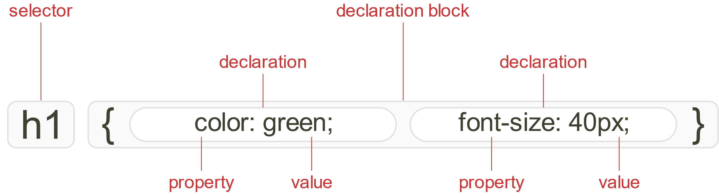
CSS Syntax
Every CSS document is a collection of CSS rules.
CSS rule has two main parts, Select and one or more declarations
Each declaration consists of a property and a value.

Slide 23
CSS Syntax
CSS Rule has two main parts:
Selector
One or more declarations
[selector] {
[declaration]
[declaration]
}

Slide 24
CSS Syntax
The CSS Selector is an identifier of the HTML element or the group of HTML elements
CSS Declarations end with a semicolon, and declaration groups are surrounded by curly brackets
body {
...
}
{
font: 16px/1.5 Verdana, sans-serif;
color: #333;
}

Slide 25
CSS Selectors
In CSS, selectors are used to target the HTML elements on our web pages that we want to style.
There are a wide variety of CSS selectors available, allowing for fine-grained precision when selecting elements to style. A CSS selector is the first part of a CSS Rule.
https://developer.mozilla.org/en-US/docs/Learn/CSS/Building_blocks/Selectors

Slide 26
CSS Selectors
Type selectors
The CSS type selector matches elements by node name.
It selects all elements of the given type within a document.
https://developer.mozilla.org/en-US/docs/Web/CSS/Type_selectors
[tag-name] {
[declaration]
[declaration]
}
h1 {
color: blue;
font-weight: bold;
}

Slide 27
CSS Selectors
Class selectors
The CSS class selector matches elements based on the contents of their class attribute.
https://developer.mozilla.org/en-US/docs/Web/CSS/Class_selectors
.[tag-name] {
[declaration]
[declaration]
}
.[class-name]{
color: blue;
font-weight: bold;
}

Slide 28
CSS Selectors
ID selectors
The CSS ID selector matches an element based on the value of the element's id attribute. For the element to be selected, its id attribute must match exactly
https://developer.mozilla.org/en-US/docs/Web/CSS/ID_selectors
#[tag-name] {
[declaration]
[declaration]
}
#[id-name]{
color: blue;
font-weight: bold;
}

Slide 29
CSS Selectors
Attribute selectors
The CSS attribute selector matches elements based on the element having a given attribute explicitly set, with options for defining an attribute value or substring value match.
https://developer.mozilla.org/en-US/docs/Web/CSS/Attribute_selectors
[attribute="value"] {
[declaration]
[declaration]
}
[href="example.com"]{
color: blue;
font-weight: bold;
}

Slide 30
CSS Selectors
Universal selector
The CSS universal selector (*) matches elements of any type.
https://developer.mozilla.org/en-US/docs/Web/CSS/Universal_selectors
* {
[declaration]
[declaration]
}

Slide 31
CSS Combinators
Descendant combinator
The descendant combinator — typically represented by a single space (" ") character — combines two selectors such that elements matched by the second selector are selected if they have an ancestor element matching the first selector.
https://developer.mozilla.org/en-US/docs/Web/CSS/Descendant_combinator
header p {
color: blue;
font-weight: bold;
}

Slide 32
CSS Combinators
Selector list
The CSS selector list (,) selects all the matching nodes. A selector list is a comma-separated list of selectors.
https://developer.mozilla.org/en-US/docs/Web/CSS/Selector_list
header, p, div {
color: blue;
font-weight: bold;
}

Slide 33
CSS Combinators
Child combinator
The child combinator (>) is placed between two CSS selectors. It matches only those elements matched by the second selector that are the direct children of elements matched by the first.
https://developer.mozilla.org/en-US/docs/Web/CSS/Child_combinator
header > p {
color: blue;
font-weight: bold;
}

Slide 34
Adding CSS to our document
There are three ways of inserting a style sheet:
External style sheet
Internal style sheet
Inline style

Slide 35
Adding CSS to our document
External Style Sheet
An external style sheet is ideal when the style is applied to many pages. Each page must link to the style sheet using the tag.
The tag goes inside the head section:
<head>
<link rel="stylesheet" type="text/css" href="style.css"
</head>

Slide 36
Adding CSS to our document
Internal Style Sheet
An internal style sheet should be used when a single document has a unique style. You define internal styles in the head section of an HTML page, by using the style tag.
<head>
<style>
body {
color: blue;
}
</style>
</head>

Slide 37
Adding CSS to our document
Inline Styles
An inline style loses many of the advantages of style sheets by mixing content with presentation.
Do not use this method unless you have no other choice!
To use inline styles, you use the style attribute in the relevant tag. The style attribute can contain any CSS property.
<div style="color: blue;">
…
</div>

Slide 38
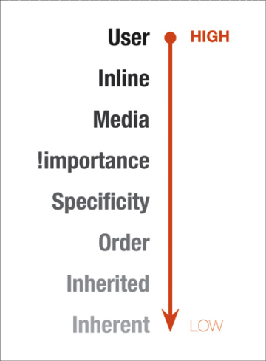
CSS Selectors Inheritance & Specificity
CSS relies heavily on specificity and style overwriting
Its in the name!
Cascading Style Sheets
Cascade Order
In increasing order of priority.
External <link>
In the <head>
Inline style attribute
Using !important

Slide 39
CSS Properties
background
background-color: #fff;
background-image: url(../image.png);
background-repeat: repeat | repeat-x | repeat-y | no-repeat;
background-position: top left;
text
color: #000;
text-align: left | right | center | justify;
text-decoration: underline | overline | line-through | none;
text-transform: uppercase | lowercase | capitalize;
text-indent: 50px;

Slide 40
CSS Properties
font
font-family: Verdana, Arial, sans-serif
font-style: italic | normal;
font-size: 20px;
font-weight: bold | normal;
border
border-style: solid | dotted | dashed | double;
border-color: red;
border-width: 2px;

